Slide 1
Introduction to DevOps
Sonika Rathi
Assistant Professor
BITS Pilani

Slide 2
Agenda
Jenkins
Jenkins Prerequisites
Prepare Jenkins environment
Jenkins Installation
Post-installation setup wizard
Customizing Jenkins with plugins

Slide 3
Jenkins
Prerequisites
Minimum hardware requirements:
256 MB of RAM
1 GB of drive space
Recommended hardware configuration for a small team:
1 GB+ of RAM
50 GB+ of drive space
Software requirements:
Java 8 - either a Java Runtime Environment (JRE) or a Java Development Kit (JDK) is fine
Jenkins is typically run as a standalone application in its own process with the built-in Java servlet container/application server (Jetty)
Jenkins can also be run as a servlet in different Java servlet containers such as Apache Tomcat or GlassFish

Slide 4
Jenkins
Prepare Jenkins environment
The most basic function of any Continuous Integration tool is to monitor source code in a version control system and to fetch and build the latest version of your source code whenever any changes are committed
The first thing needed is to install Java
Need a version control system like Git
Open an GitHub Account

Slide 5
Jenkins
Prepare Jenkins environment Contd..
Set-up the Java Runtime Environment [JRE]; A recent version of Java
Check Java Version on System with
$java -version
Install and configure Git
On Debian Linux Machine such as Ubuntu
$ sudo apt-get install git-core
In Fedora
$sudo yum install git-core
Post installation we can check the version with
$git –version
Windows
Get installer from https://git-scm.com/downloads
Set-up a GitHub Account

Slide 6
Jenkins
Prepare Jenkins environment Contd..
Configure SSH Key:
GitHub uses SSH keys to establish a secure connection between your computer and the GitHub servers [Linux]
Create a Sample Repository:
Login to the your GitHub Account
Then create a repository
Once the Repository is created; get this cloned to your local machine
$git clone <Path of the Repository>

Slide 7
Jenkins
Installation: macOS Platform
To install from the website, using a package:
Download the latest package [https://jenkins.io/download/]
Open the package and follow the instructions
Jenkins can also be installed using brew:
Install the latest release version
$ brew install jenkins
Install the LTS [Long Term Support] version
$ brew install jenkins-lts

Slide 8
Jenkins
Installation: Debian/Ubuntu Platform:
install Jenkins through apt :
$ sudo apt-get install jenkins
Setup Jenkins as a daemon launched on start in /etc/init.d/jenkins
Create a ‘jenkins’ user to run this service
Log file location incase of troubleshooting : /var/log/jenkins/jenkins.log
Populate /etc/default/jenkins with configuration parameters for the launch
Set Jenkins to listen on port 8080
Note: if the port has been occupied already i.e. 8080 then edit the /etc/default/jenkins to replace the line HTTP_PORT=8080 with another port available

Slide 9
Jenkins
Installation: Windows Platform
To install from the website, using the installer:
Download the latest package [https://jenkins.io/download/]
Open the package and follow the instructions

Slide 10
Jenkins
Post-installation setup wizard
Unlocking Jenkins: [Linux]
first access a new Jenkins instance, will asked to unlock it using an automatically generated password
Step1:
Browse to localhost:8080 [or] localhost:<port-number>, whichever port configured for Jenkins when installing it
And wait until the Unlock Jenkins page appears
Step2:
Go to the Jenkins console log output
Copy the automatically-generated alphanumeric password [between the 2 sets of asterisks]
Step3:
On the Unlock Jenkins page, paste this password into the Administrator password field
Click Continue
Unlocking Window:
Copy the password from initialAdminPassword.txt present in secrets folder of installed Jenkins directory

Slide 11
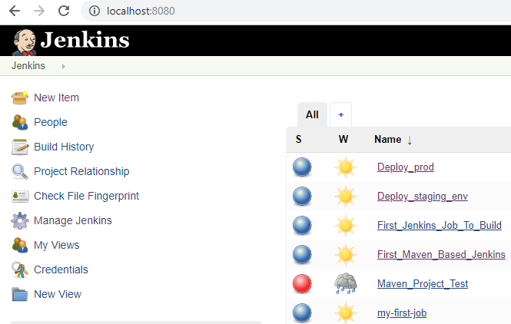
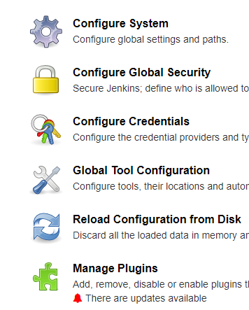
Jenkins
Customizing Jenkins with plugins
At Customize Jenkins page we can install any number of useful plugins
Install suggested plugins - to install the recommended set of plugins, which are based on most common use cases
We can install (or remove) additional Jenkins plugins at a later point in time via the Manage Jenkins > Manage Plugins page in Jenkins

Slide 12
Thank You!
In our next session:

